Slide 1

Discovery Café
State College of Florida
2011-2012

Slide 2
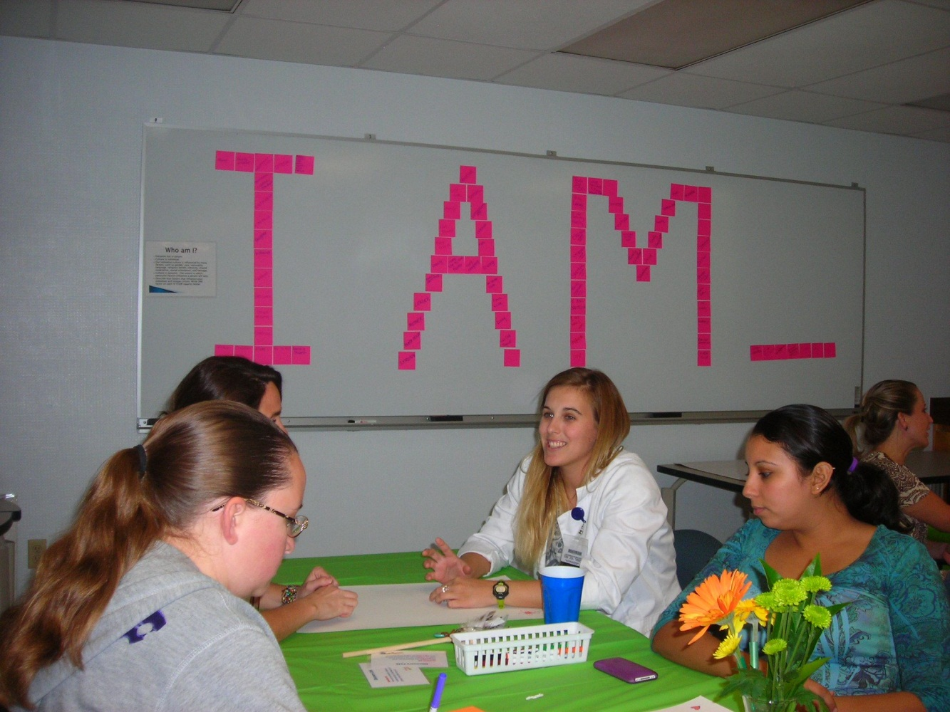
Create a Hospitable Space

Slide 3
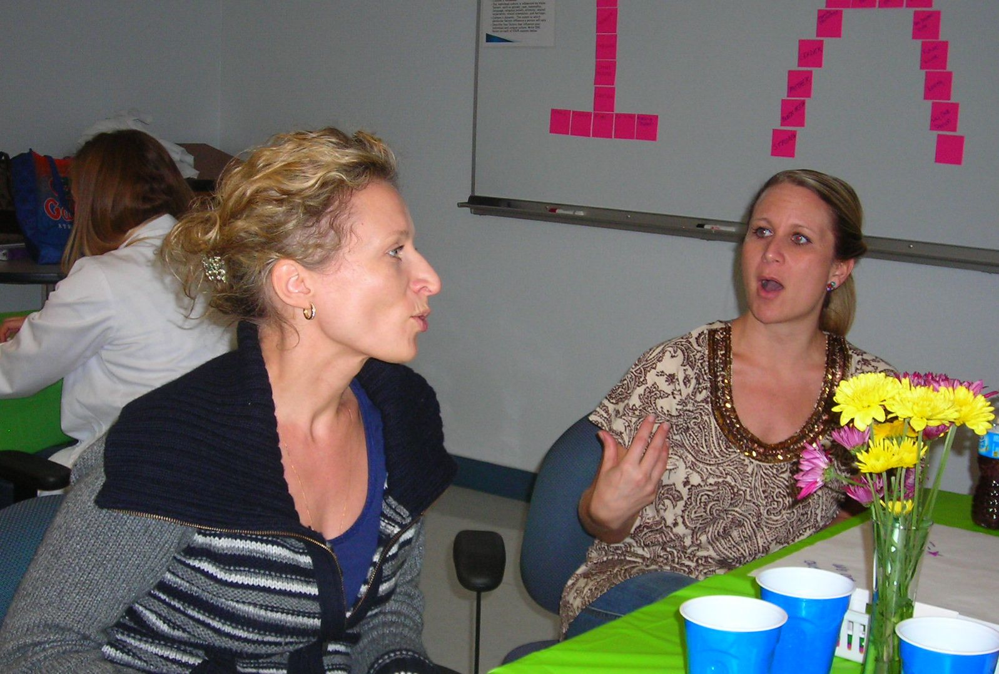
Pose Questions that Matter

Slide 4
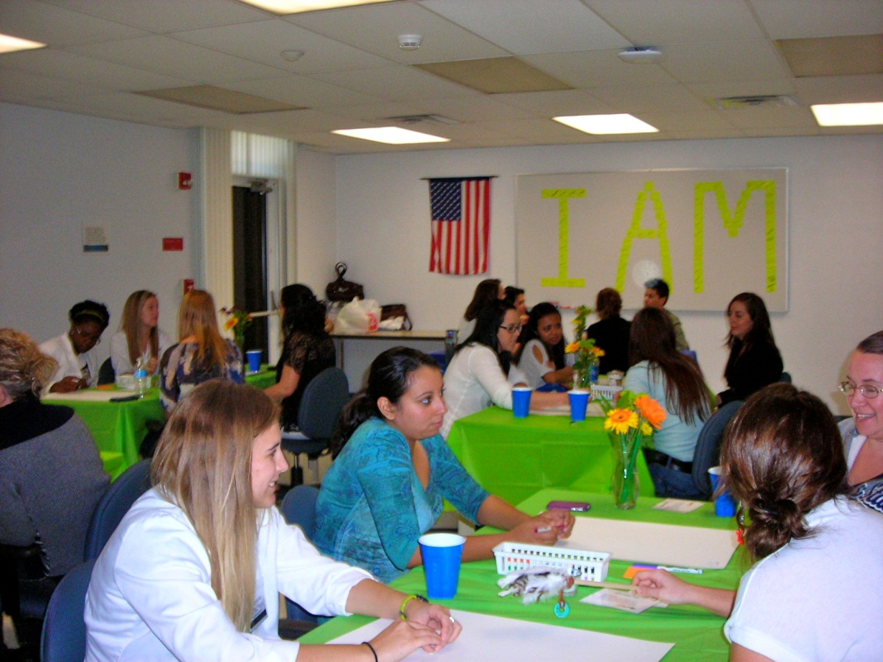
Encourage Everyone’s Participation

Slide 5
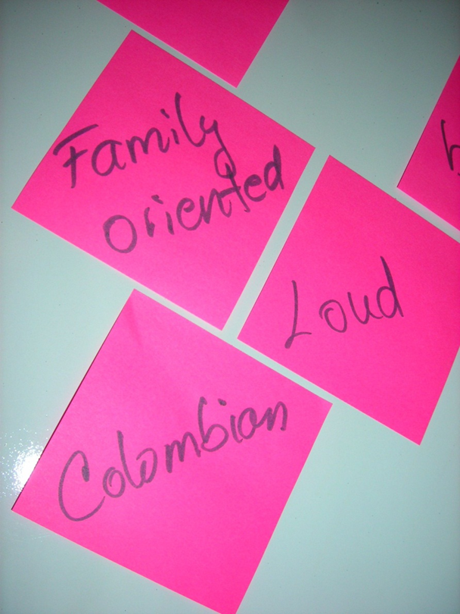

Listen for Insights and Share Discoveries

Slide 6
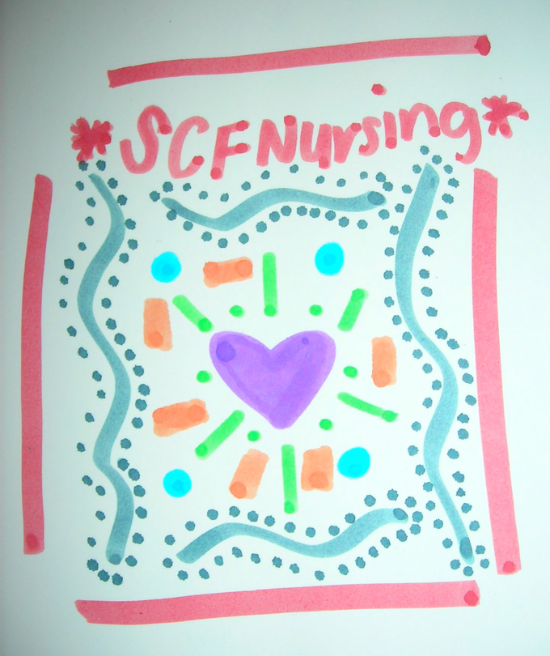

Connect Diverse Perspectives

